Slide 1

KJEI Hostel Complaint Tracker
KJ’s Educational Institute
K J College of Engineering & Management Research , Pune
Department Name: Electronics & Communication Engineering (Advanced Communication Technology)
A.Y: 2025-26 (Sem-III)
Name:
Roll no:
Guided by
Prof. V.S.KHANDAGALE
Ajinkya Pardeshi
Mayur Dhoran
Atharv Mahajan
39
10
30
S.E. (ACT)- 2025-26
Department of advance communication technology

Slide 2
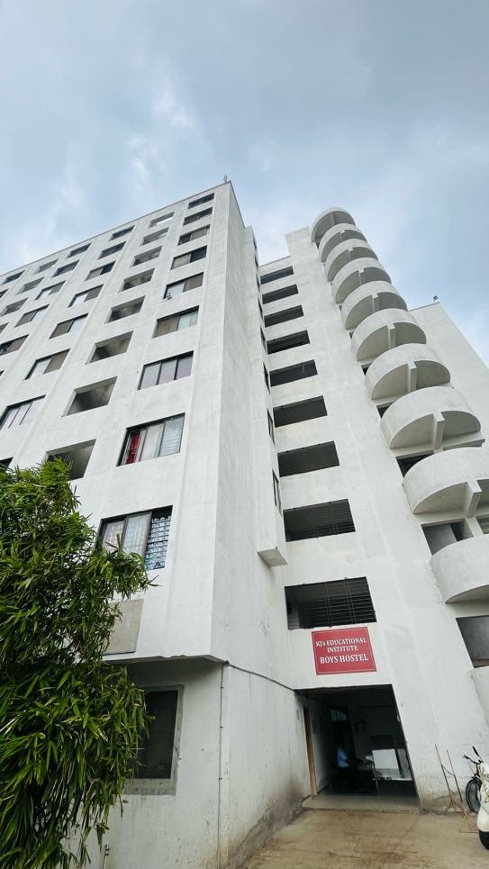
Abstract :-
The Hostel Complaint Tracker Website is a centralized digital platform designed to streamline the process tracking and resolving complaints within hostel premises. This system aims to enhance communication between hostel residents and administration by offering a transparent, efficient, and user-friendly interface. Users can submit complaints related to maintenance, hygiene, security, and other hostel issues, while administrators can manage, prioritize, and resolve them in a timely manner. With features such as real-time status updates, categorized complaint types, and automated notifications, the platform significantly reduces manual effort and delays and improved living conditions in hostels.

Slide 3
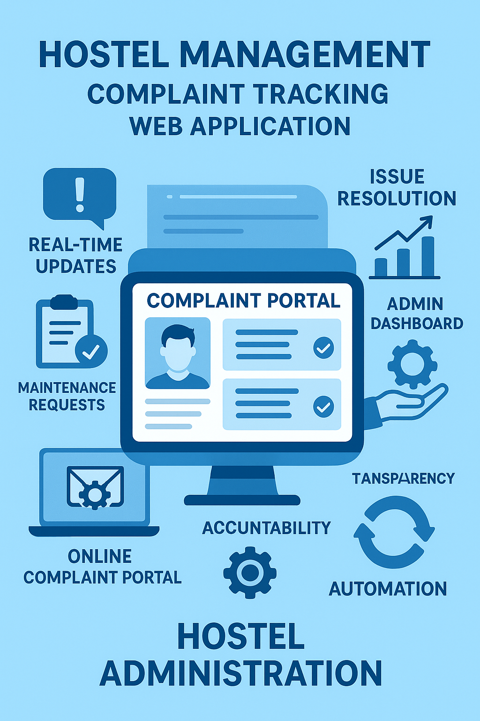
Keywords:-
Hostel Management
Complaint Tracking
Web Application
Issue Resolution
Real-Time Updates
User-Friendly Interface
Maintenance Requests
Admin Dashboard
Transparency
Accountability
Online Complaint Portal
Automation
Hostel Administration

Slide 4
Introduction:-
Managing complaints and maintenance issues in hostels can be a challenging task when handled manually. Traditional methods like paper-based registers or informal messaging often lead to delays, miscommunication, and lack of accountability.
The Hostel Complaint Tracker is a web-based solution designed to address these inefficiencies by providing a structured platform where students can easily lodge complaints and hostel authorities can manage and resolve them efficiently.
This system ensures transparency, quick response times, and proper documentation of all issues reported, making hostel life more comfortable and well-managed for students. It also empowers hostel staff with tools to categorize, track, and resolve complaints systematically.

Slide 5

Project Objectives:-
Simplify Complaint Submission: Provide an easy-to-use platform for hostel residents to lodge complaints online.
Ensure Transparency: Enable real-time tracking of complaint status to build trust and accountability.
Speed Up Resolution: Help hostel staff manage, prioritize, and resolve issues more efficiently.
Organize Complaint Data: Maintain a structured record of all complaints for future reference and analysis.
Reduce Manual Work: Minimize paperwork and informal communication through automation and notifications.
Improve Living Conditions: Contribute to better hostel management and an improved living environment for students.

Slide 6
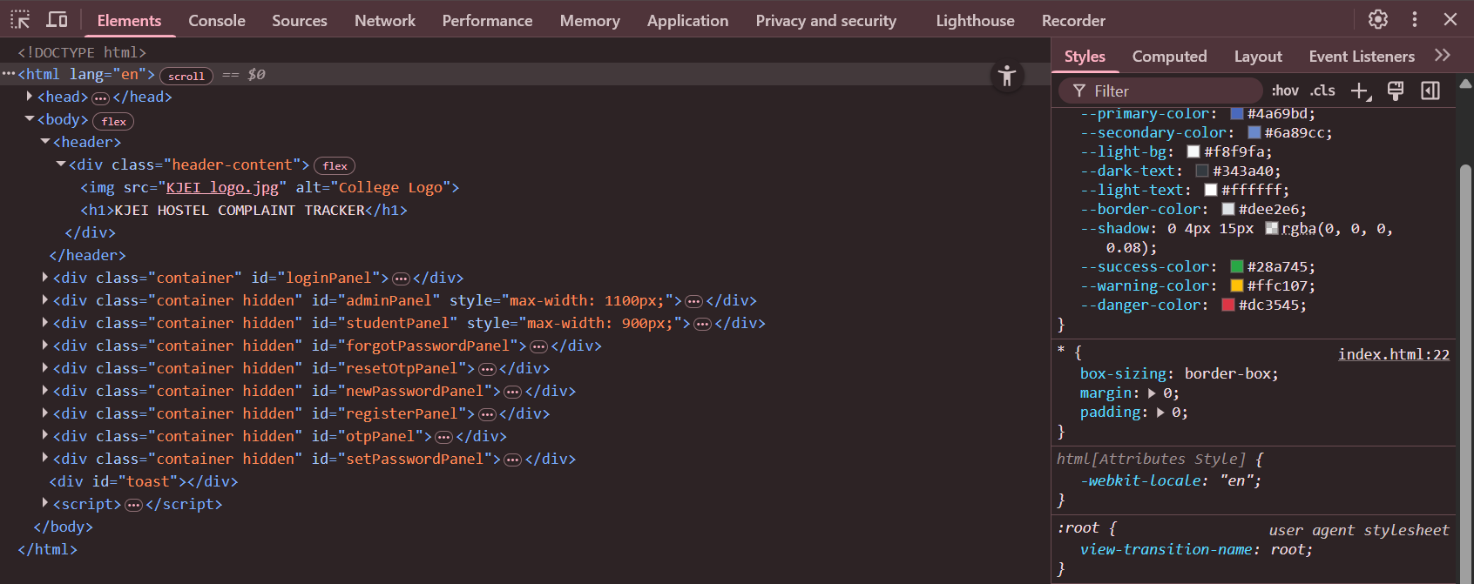

Software Requirement:-
Code using html and css language for front end and website designing
json language also used for backend use
Google spread sheet is also used for lodging complaint

Slide 7
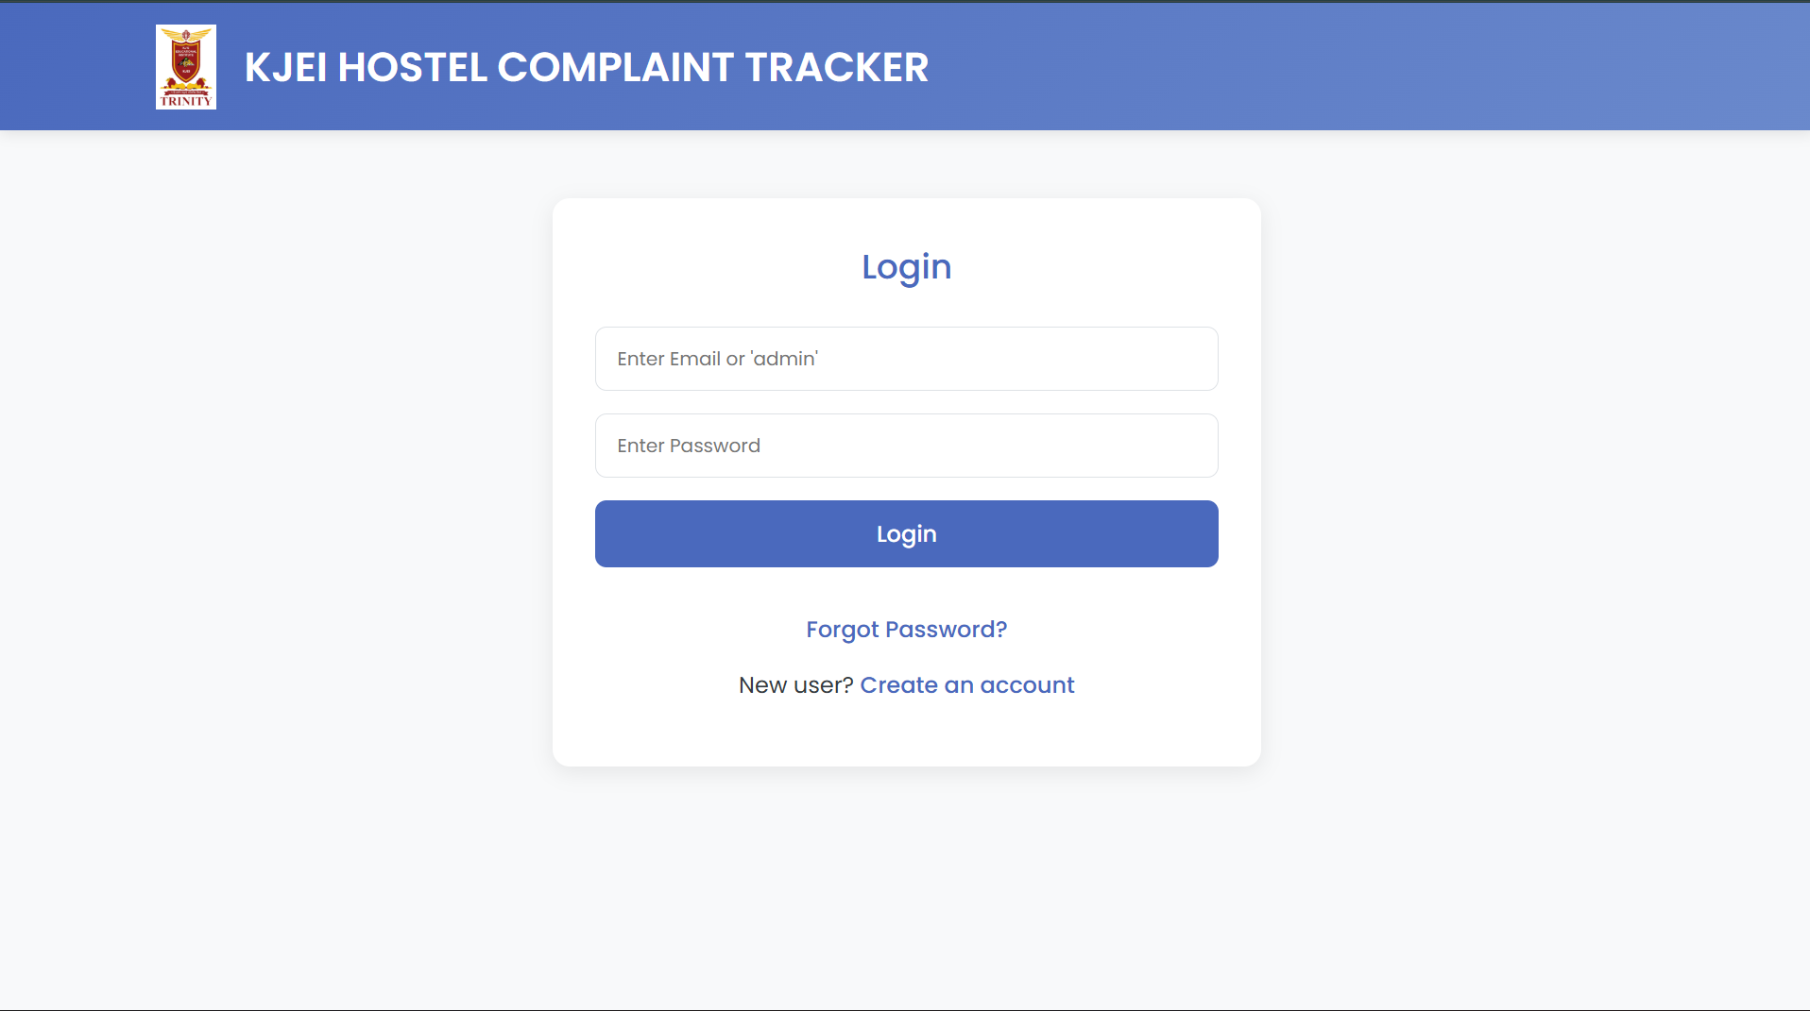

Slide 8
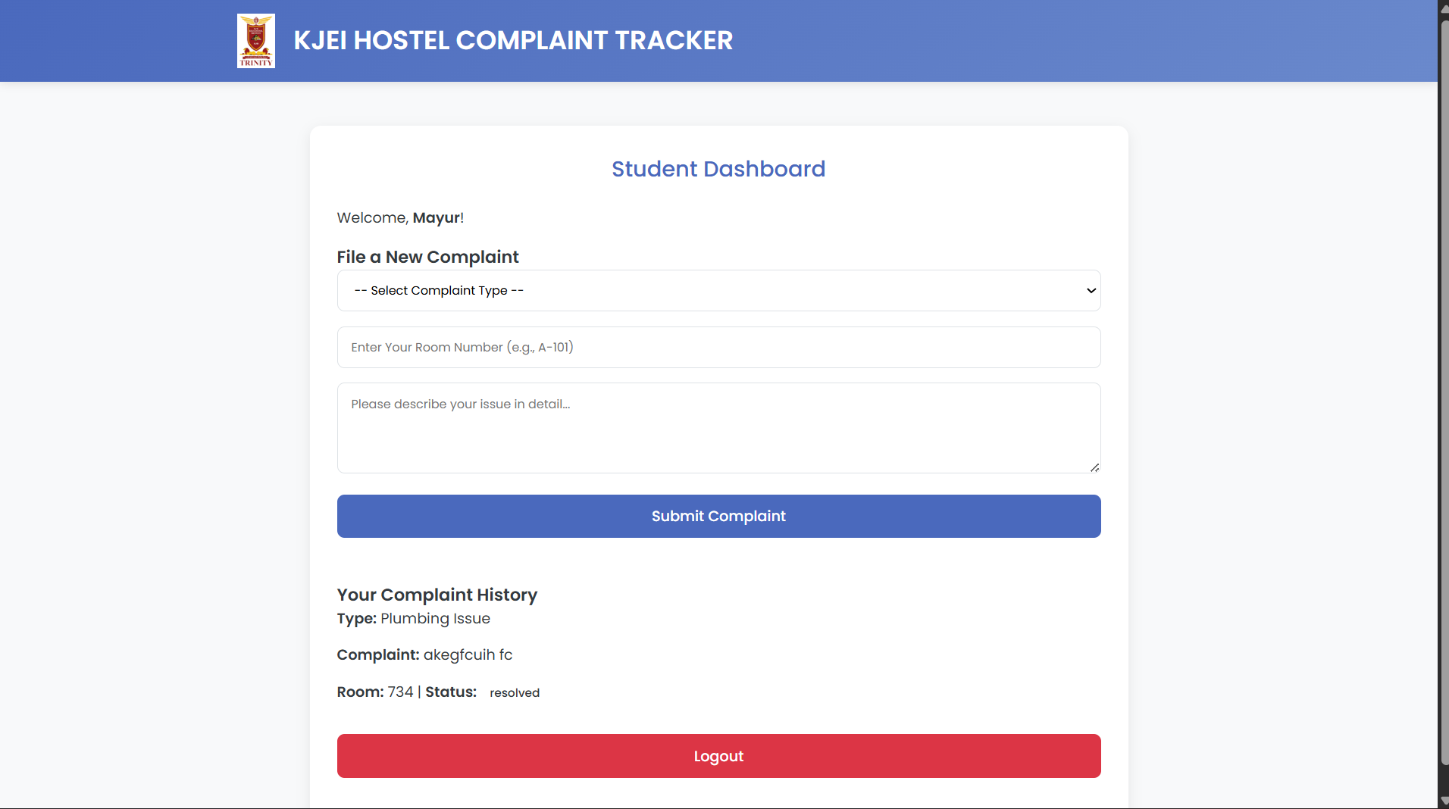

Slide 9
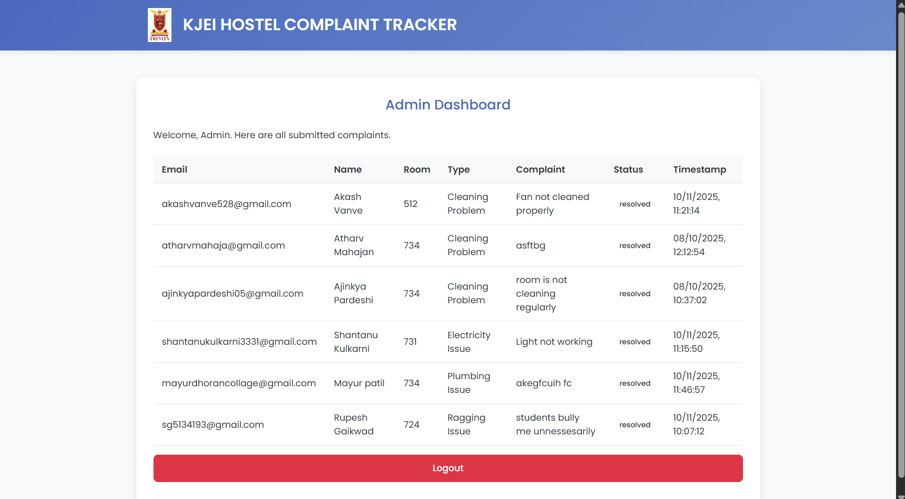

Slide 10
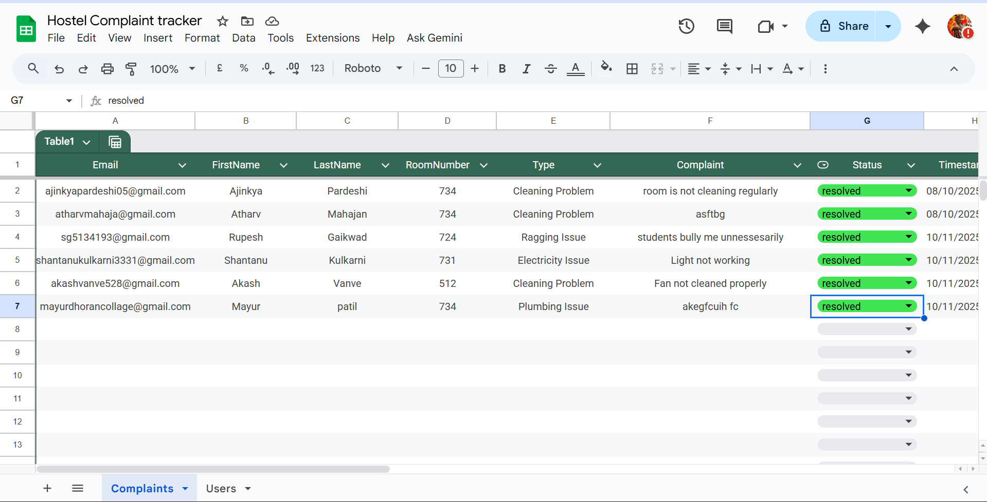

Slide 11


